Slide 1

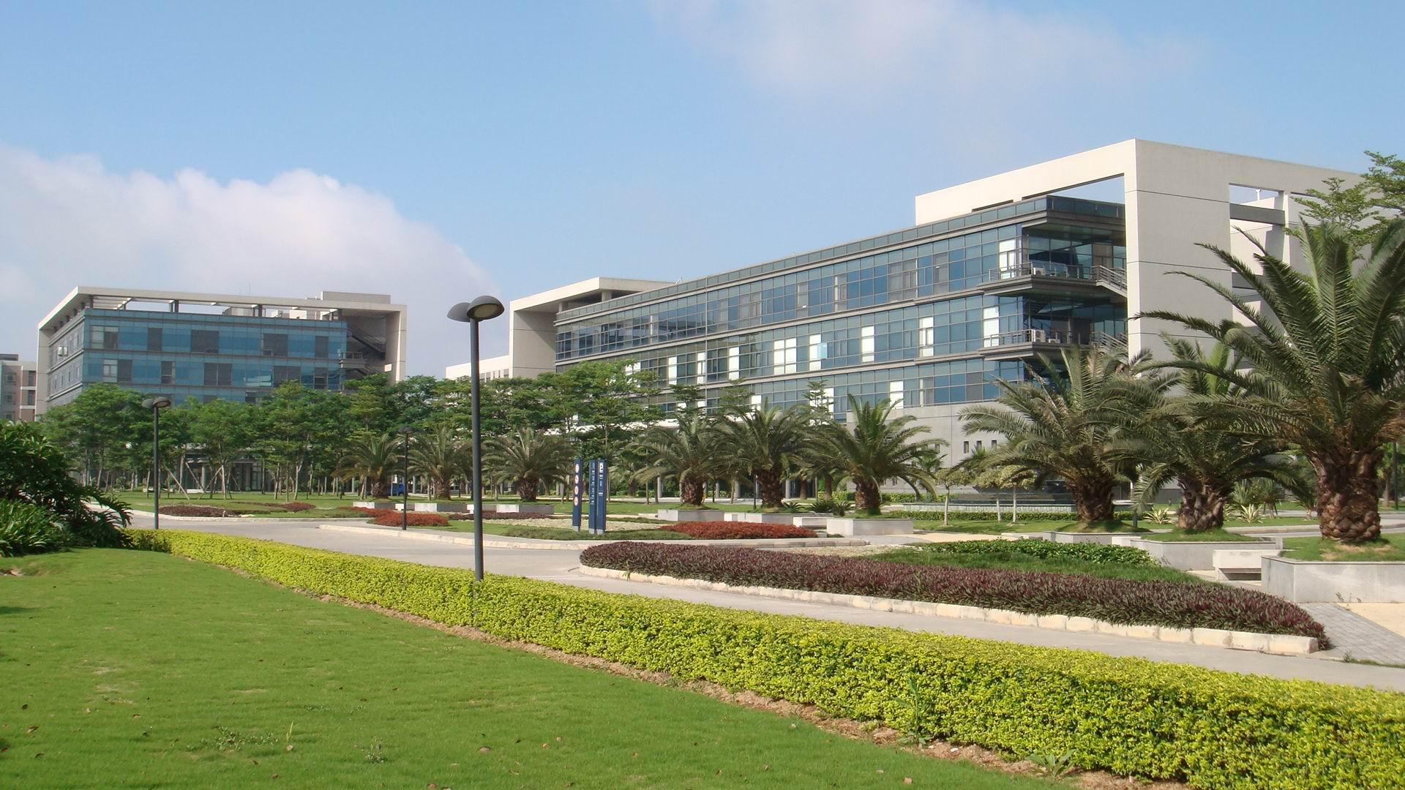
实习开题报告
连续帧定位策略
导师： 杨宇尘
实习生：徐佳飞
时间：2021.07.29
成为全球知名的公司，树立中国企业在全世界健康、长久的典范

Slide 2
Outline
Task Introduction
Research
Goal (Dataset)
Preliminary model design

Slide 3
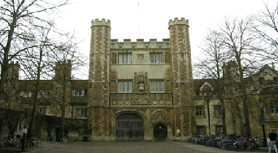
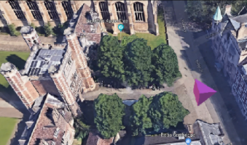
Task Introduction
Long-term visual localization：
Visual localization is the problem of estimating the 6 Degree-of-Freedom (DoF) camera pose from which a given image was taken relative to a reference scene representation. Visual localization is a key technology for applications such as Augmented, Mixed, and Virtual Reality, as well as for robotics, e.g., for self-driving cars.
Image taken from the Cambridge Landmarks dataset[1]
[1] Alex Kendall, Matthew Grimes, and Roberto Cipolla. PoseNet: A Convolutional Network for Real-Time 6-DOF Camera Relocalization. In ICCV, 2015.

Slide 4
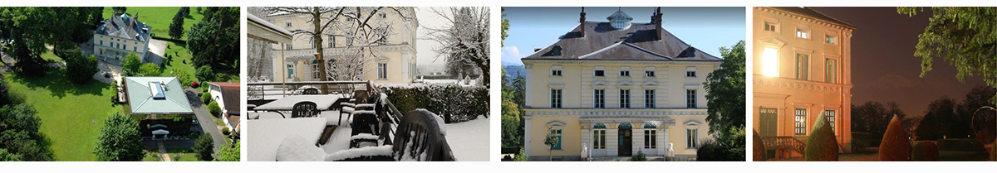
Task Introduction
Visual localization challenges:
Illumination changes i.e. is it possible to localize a night time image if the map images were taken during daytime?
Dynamic scenes with moving objects that might not have been present when the map was created
Occlusion of the scene by an object or person
Strong viewpoint changes between the map and query images
Example of typical challenges visual localization is facing: illumination changes, different scales, different seasons, and occlusions.

Slide 5
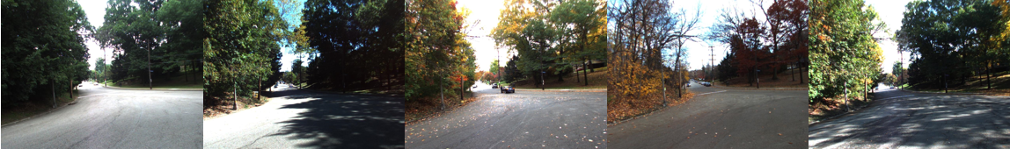
Task Introduction
Long-term Visual localization challenges:
Illumination changes
Images taken in different seasons or weather conditions
Occlusion of the scene by an object or person
Dynamic objects in query images
Local descriptors fail due to seasonal variations, illumination changes, and moving objects.

Slide 6
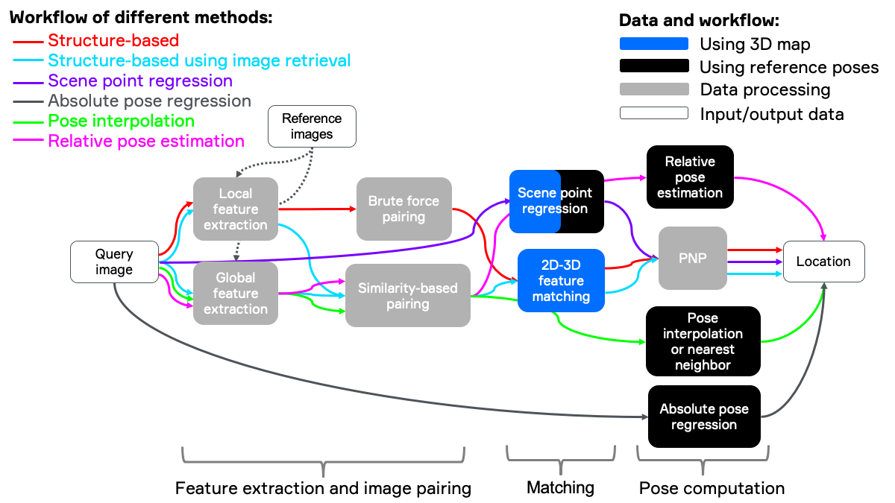
Research
Structure-based methods
建图
局部特征点匹配（ SIFT、SURF、BRIEF 描述子）
2D-3D 匹配
PNP
Image retrieval-based methods
匹配全局描述子，以找到最相似的图像，这些图像形成图像对
利用这些图像对建立局部关键点匹配
2D-3D 匹配
PNP
End-to-End localization
直接姿势回归，可以使用深度神经网络 (DNN) 直接确定 2D 像素位置和 3D 点之间的对应关系
Kapture -2020
NetVlad -2016 CVPR
AP-Gem -2019 ICCV
DELG -2020 ECCV
Long-term Visual localization？
-K. M. Yi, E. Trulls, V. Lepetit, and P. Fua, “Lift: Learned invariant feature transform,” in European Conference on Computer Vision. Springer, 2016, pp. 467–483.
-Torsten Sattler, Will Maddern, Carl Toft, Akihiko Torii, Lars Hammarstrand, Erik Stenborg, Daniel Safari, Masatoshi Okutomi, Marc Pollefeys, Josef Sivic, Fredrik Kahl, and Tomas Pajdla. Benchmarking 6DoF Outdoor Visual Localization in Changing Conditions. In CVPR, 2018.

Slide 7
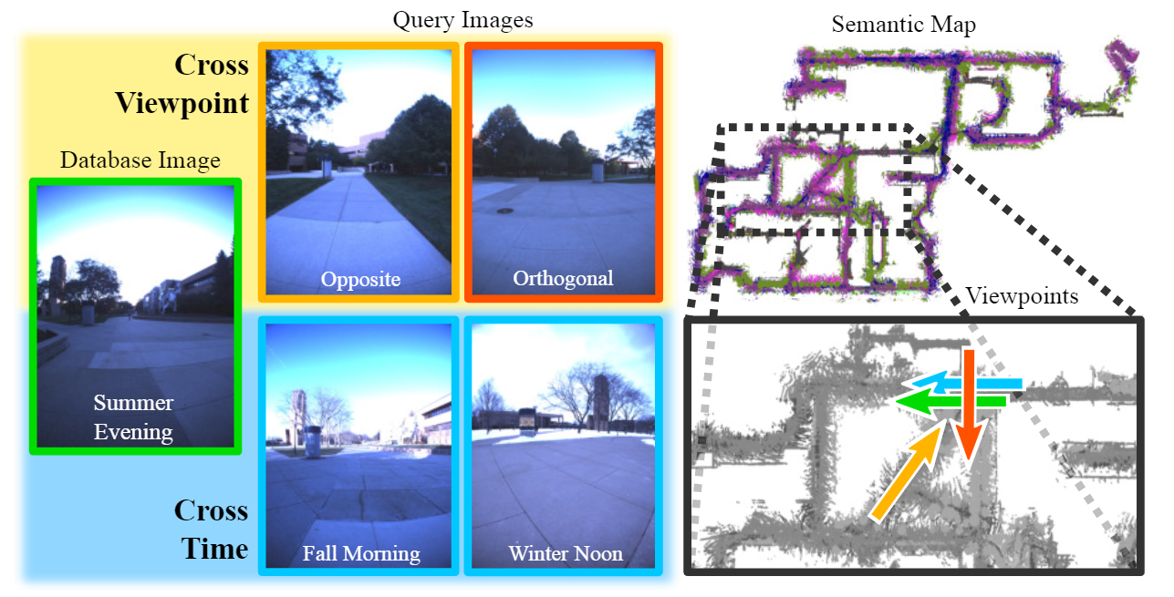
Research
Semantic visual localization
如今，长期视觉定位方法通常使用语义分割作为不变的场景表示，因为每个场景部分的语义不应该受到季节性变化和其他变化的影响。
Combine semantics and geometry
High-level features
Larsson, Mans, et al. "Fine-grained segmentation networks: Self-supervised segmentation for improved long-term visual localization." Proceedings of the IEEE/CVF International Conference on Computer Vision. 2019.
Notes:
FGSN-细粒度分割网络

Slide 8
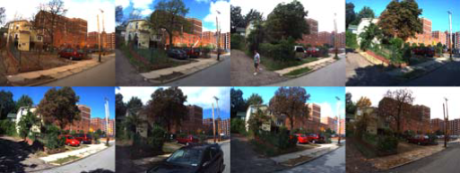
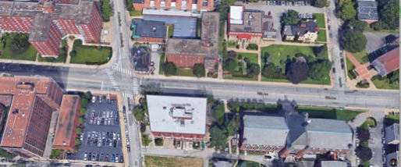
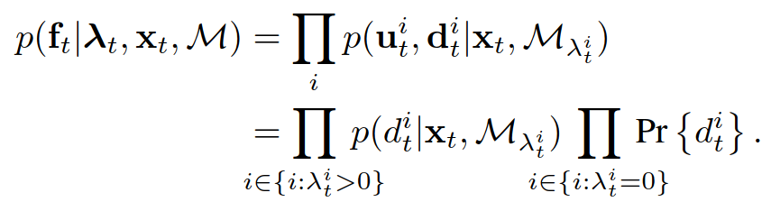
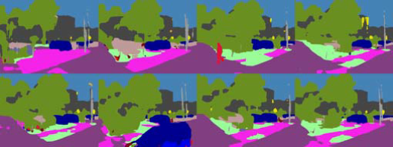
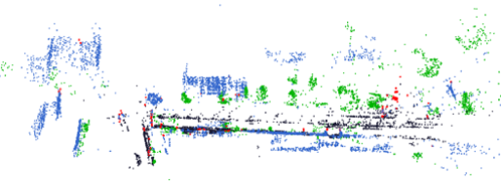

Research
Long-term Visual Localization using Semantically Segmented Images
——Particle filter + semantic segmentation
Database image with
Ground truth
Semantic
Point cloud
Particle filter
Trajectory
Particle likelihood:
Particle weight update:
semantic segmentation
蓝色是“建筑”，绿色是“自然”，黑色是“平地”，红色是“静止物体”。
式中，W_{t}^{（j）}是与状态为X_{t}^{（j）}的第j个粒子相关联的权重，s是设置为3的缩放参数，n_{λt}是投影到图像中的建图点的数量，N_{c}=400是一个截止点，其中图像中的更多投影的点不提供更多信息
Mapping
Localization
λ^{i}_{t}
图像中的像素点有无对应的地图点
E. Stenborg, C. Toft, and L. Hammarstrand. Long-Term Visual Localization Using Semantically Segmented Images. In 2018 IEEE International Conference on Robotics and Automation (ICRA), 2018.

Slide 9
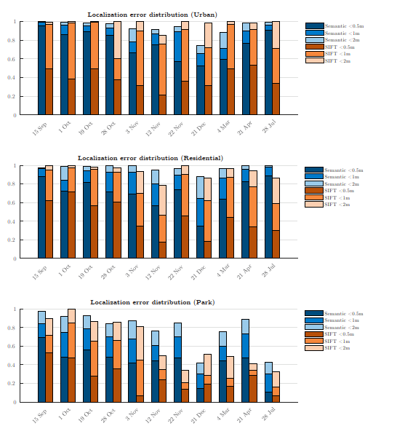
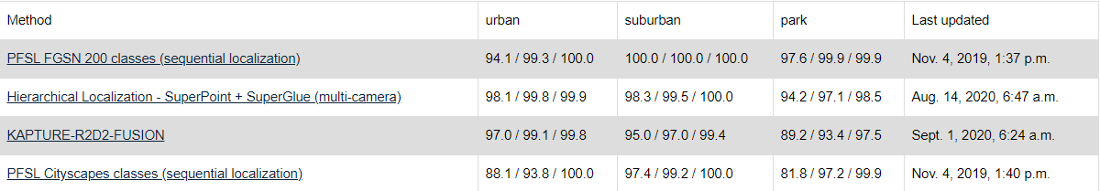
Research
Long-term Visual Localization using Semantically Segmented Images
——Particle filter + semantic segmentation
Performance——CMU seasons
Rank on benchmark——Extended CMU seasons
优点：
只使用语义点云，地图小
在多季节场景下精度较高
缺点：
3D点的语义类别与用于定位的图像中的类别不匹配
道路旁的地形经常被错误的分类
粒子滤波计算量大
追踪丢失后处理措施
CMU seasons dataset效果一般
E. Stenborg, C. Toft, and L. Hammarstrand. Long-Term Visual Localization Using Semantically Segmented Images. In 2018 IEEE International Conference on Robotics and Automation (ICRA), 2018.

Slide 10
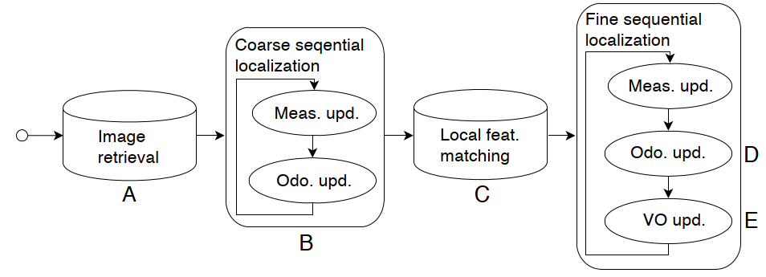
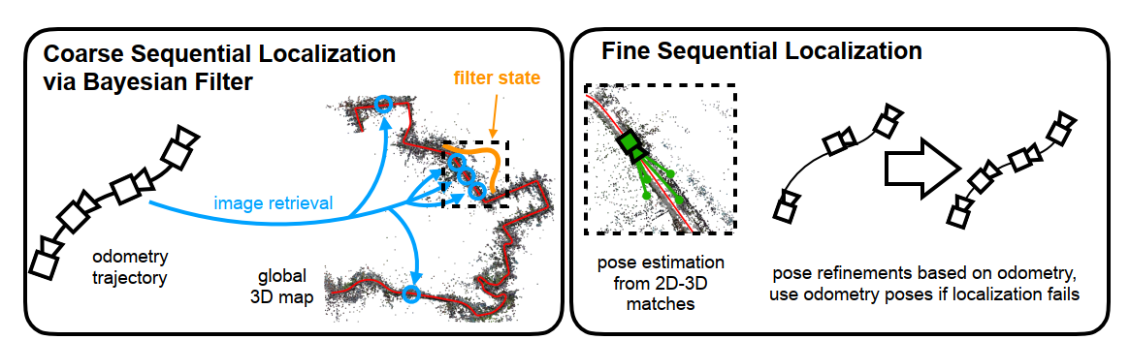
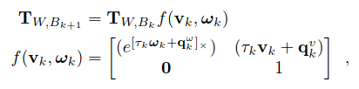
Research
Using Image Sequences for Long-Term Visual Localization
——sequence-based localization pipeline（odometry + coarse localization + fine localization）
A: DenseVLAD-图像检索提供可能的一组位置
B: Coarse ﬁlter-将A中的信息与里程计信号结合获得粗定位估计
C: SIFT or D2-Net- 局部特征匹配
D: Odometry (6-DoF)
E: Original ORB-SLAM
T_{W,Bk} the body (B_{k}) at times tk in the world coordinate system (W)
The motion from time t_{k} to t_{k+1}
Stenborg, Erik, Torsten Sattler, and Lars Hammarstrand. "Using Image Sequences for Long-Term Visual Localization." 2020 International Conference on 3D Vision (3DV). IEEE, 2020.

Slide 11
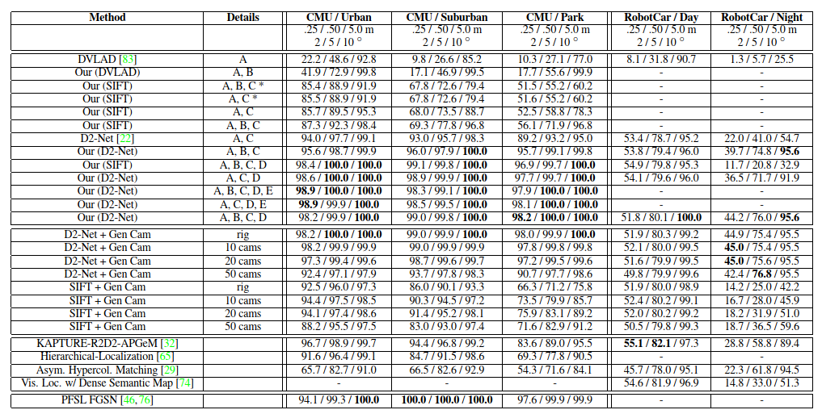
Research
Using Image Sequences for Long-Term Visual Localization
——sequence-based localization pipeline（odometry + coarse localization + fine localization）
Performance——Extended CMU seasons and RobotCar Seasons datasets
优点：
针对性优化了对于匹配数量不足的问题
引入了时序的特征
缺点：
使用传统的特征点检测描述方法
里程计漂移问题未有效解决

Slide 12
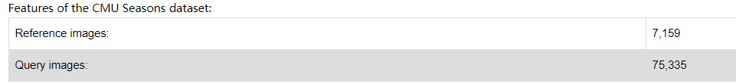
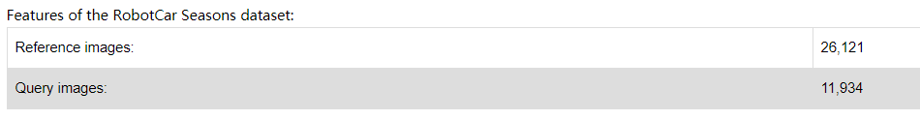
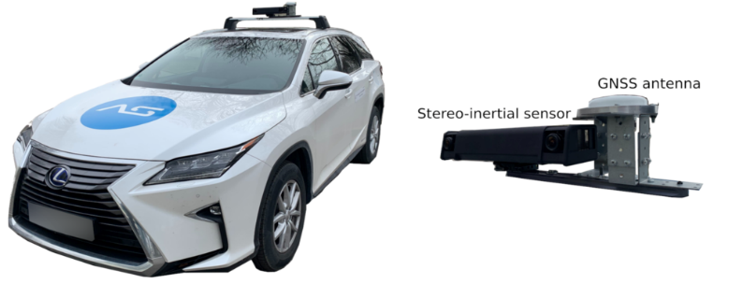
Dataset
Datasets of visual localization
CMU-seasons datasets (美国匹兹堡城市-乡村道路)
RobotCar Seasons datasets (英国牛津市道路）
4seasons-datasets
单一季节、光照变化

Slide 13
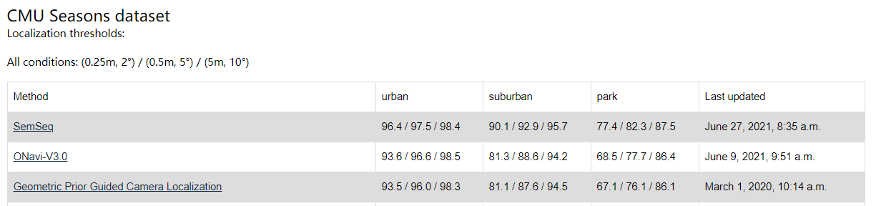
Goal

Slide 14
Preliminary model design
Semantic segmentation + Sequence-based methods
Module I: Observation + odometry mapping
Module II: Image retrieval
Module III: Coarse localization
Module IV: Fine localization
Semantic consistency
Semantic segmentation
Initial pose
Query image
Odometry trajectory
Sequence-based
Semantic map
Adjacent frame
Observation constrains
Observation constrains
…
语义定位中主要有两个问题：
图像语义分割不准确造成定位误差较大，例如冬天下雪后
较为单一的场景，图像类似，公园的树林
第一个问题可以通过更好的语义分割算法来改善
第二个问题，将物体进行更细致的语义分类

Slide 15
谢谢
请各位指正！
成为全球知名的公司，树立中国企业在全世界健康、长久的典范

